Slide 1
Review of Regression
“Manufacturer’s Suggested Retail Price (MSRP)”
Data set: MSRPv3.jmp

Slide 2
Supervised vs. Unsupervised Data Mining Methods (Directed vs. Undirected)
With supervised data mining methods, you have a well-defined response (target) variable—e.g., regression.
Unsupervised methods do not have a response variable.

Slide 3
Regression: Metric Response Variables
Predictor Variables Are: | Response (Target) Variable is: |  | No Response (Target) Variable
 | Metric | Categorical
Metric | Regression
Categorical | Regression

Slide 4
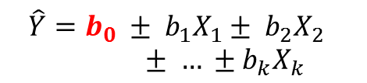
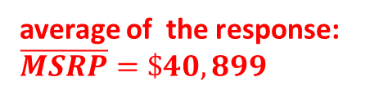
Regression Review
name of the response variable
list of predictor variables
average of the response: $\overline{MSRP}=\$40,899$
number of observations (rows):
n = 1,569
$$\hat{Y}=b_{0} ± b_{1}X_{1}± b_{2}X_{2 } ± … ±b_{k}X_{k }$$
JMP: Analyze > Fit Model
One predictor: Analyze > Fit Y by X

Slide 5
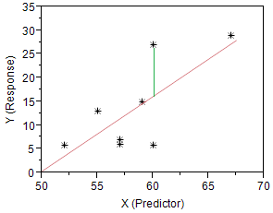
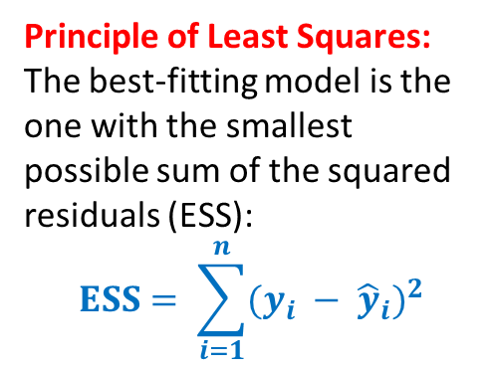
Regression Review (cont.)
Principle of Least Squares: The best-fitting model is the one with the smallest possible sum of the squared residuals (ESS):
$$ESS= \sum_{i=1}^{n}{{(y_{i} − {\hat{y}}_{i})}^{2}}$$
Sums of Squares:
Model (MSS or RSS)
Error (ESS)
Total (TSS)
JMP: Analyze > Fit Model
One predictor: Analyze > Fit Y by X

Slide 6

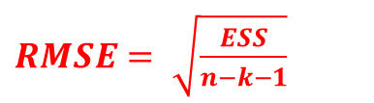
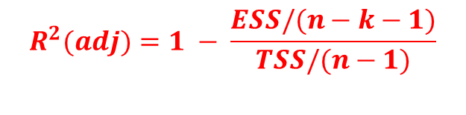
Regression Review (cont.)
$$R^{2}=1 − \frac{ESS}{TSS}$$
“Primary” Regression Statistics
$$R^{2}(adj)=1 − \frac{ESS/(n−k−1)}{TSS/(n−1)}$$
$RMSE= \sqrt{\frac{ESS}{n−k−1}}$
coefficient estimates
JMP: Analyze > Fit Model
One predictor: Analyze > Fit Y by X

Slide 7
Regression Review (cont.)
“Secondary” Regression Statistics
testing the statistical significance of the overall model
testing the statistical significance of individual predictors
JMP: Analyze > Fit Model
One predictor: Analyze > Fit Y by X

Slide 8
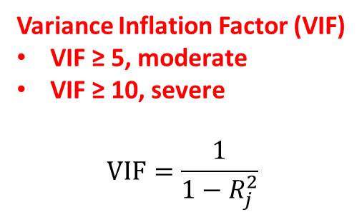
Regression Review (cont.)
Model Diagnostics: Multicollinearity
Variance Inflation Factor (VIF)
VIF ≥ 5, moderate
VIF ≥ 10, severe
$$VIF=\frac{1}{1−R_{j}^{2}}$$
To display VIF, first create the regression display. Then right-click any value in Parameter Estimates , Columns > VIF

Slide 9
Regression Review (cont.)
Scatterplot matrix
(also for multicollinearity)
JMP: Analyze > Multivariate Methods > Multivariate

Slide 10
Regression Review (cont.)
Perfect Multicollinearity
When adding/subtracting the values for two or more predictor variables, if the result is the same constant for all observations, you have perfect multicollinearity. When this occurs, the model cannot be estimated. More generally, perfect multicollinearity occurs when one predictor variable is a linear combination of other predictors.
 | Percentage of the Residents Whose Race Is:
 | African American | Hispanic | White | Asian | Other
City A | 35.4% | 22.5% | 21.7% | 5.3% | 15.1%
City B | 15.4% | 22.8% | 56.3% | 3.2% | 2.3%
City C | 5.1% | 19.7% | 73.2% | 0.9% | 1.1%
˸ | ˸ | ˸ | ˸ | ˸ | ˸
City ZZZ | 25.8% | 16.5% | 33.3% | 12.7% | 11.7%

Slide 11
Regression Model Assumptions
Linearity
Zero error mean
Error normality
Constant error variance (homoskedasticity)
Nonautocorrelation
JMP:
Red triangle > Row Diagnostics > Plot Residual by Predicted; scroll down.
Red triangle > Save Columns > Residuals. Find the new column in the JMP Data Table. Analyze > Distribution > Residual MSRP

Slide 12
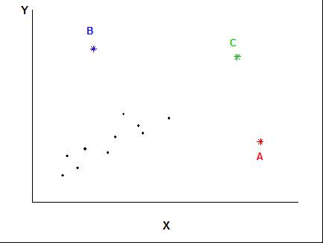
Row Diagnostics: Leverage and Influence
Leverage: an observation with an extreme value for one (or more) of the predictor variables
Large residual: an observation whose residual is large
Influential: an observation that has a large influence on one (or more) of the regression coefficients—usually both leveraged and large residual

Slide 13
Leverage and Influence (cont.)
Leverage: detected by “hats”
Influence: detected by Cook’s D
JMP:
Red triangle > Save Columns > Hats. Find the new column in the JMP Data Table. Analyze > Distribution …
Same as above for Cook’s D

Slide 14
Regression: Curve Fitting
JMP:
Fit Y by X > … > OK. Red triangle > Fit Line
Red triangle > Fit Spline > 0.01, flexible. Use the slider to change spline appearance

Slide 15
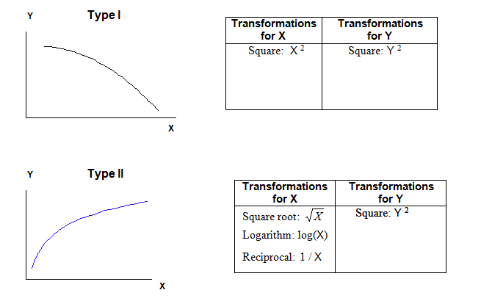
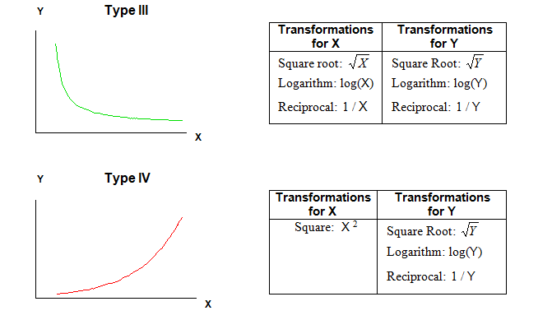
Regression: Curve Fitting (cont.)

Slide 16
Different Regression Lines for Different Groups
Never, never, never use polychotomous* predictors in a regression model in their original form.
*categorical variables with more than two outcomes (like Type)—also known as multinominal
JMP: Analyze > Fit Y by X > … OK. Red triangle > Group By… >Type > OK. Red triangle > Fit Line
Dummy variables for each “Type” will be used to model intercept differences
Interactive variables (e.g., Sedan * Wheelbase) will be used to model slope differences

Slide 17
Prediction with Regression
Given “new” values for the predictor variables, we use the estimated regression equation to predict “new” (aka, unknown) values for the response.
Estimated Model:
MSRP = 65,773.2 + 4.3 Curb Weight – 2300.8 MPG City
New car: Curb Weight = 5400 lbs
MPG City = 29
MSRP_{new} = 65,773.2 + 4.3(5400) – 2300.8(29)
= $22,270

Slide 18
Prediction with Regression (cont.)
95% “Individual” Confidence Curves—for predicting individuals
95% “Fit” Confidence Curves—for predicting averages

Slide 19
Explanatory (Descriptive) vs. Predictive Regression Models
Explanatory Models: designed to understand the relationship between the response variable and the predictor variables.
Predictive Models: predict out-of-sample (future) values of the response variable. Good models are those whose predictions are as accurate as possible.

Slide 20
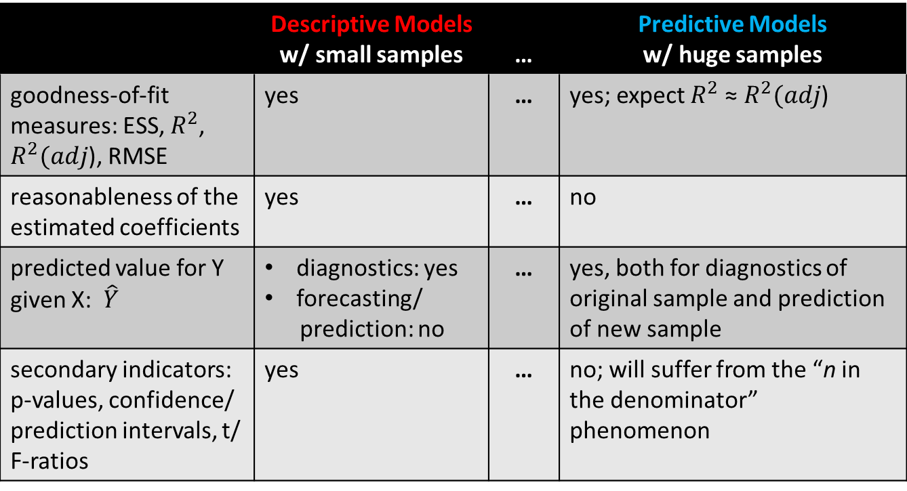
Regression: What’s Useful for What?
 | Descriptive Models w/ small samples | … | Predictive Models w/ huge samples
goodness-of-fit measures: ESS, $R^{2}$, $R^{2}(adj$), RMSE | yes | … | yes; expect $R^{2}$ ≈${ R}^{2}(adj$)
reasonableness of the estimated coefficients | yes | … | no
predicted value for Y given X: $\hat{Y}$ | diagnostics: yes forecasting/ prediction: no | … | yes, both for diagnostics of original sample and prediction of new sample
secondary indicators: p-values, confidence/ prediction intervals, t/ F-ratios | yes | … | no; will suffer from the “n in the denominator” phenomenon

Slide 21
What’s Useful for What? (cont.)
 | Descriptive Models w/ small samples | … | Predictive Models w/ huge samples
multicollinearity and its indicators | critical | … | not relevant; multicollinearity doesn’t bias regression coefficients. Except: perfect multicollinearity must be dealt with
linearity | yes | … | critical
residual normality | important in small sample sizes | … | not important
residual heteroskedasticity | important, because it influences the secondary indicators | … | important, because it might indicate possible improvements in fit
outliers/leverage | critical | … | maybe

Slide 22
Predictive Models: Partitioning
Y | X1 | X2 | X3 | X4
1118 | 66 | 8 | 846.06 | 1
1107 | 49 | 1 | 87.44 | 0
1106 | 26 | 2 | 120 | 0
1148 | 145 | 1 | 782.08 | 1
. | . | . | . | .
. | . | . | . | .
. | . | . | . | .
2106 | 356 | 1 | 79 | 0
1104 | 264 | 1 | 318.5 | 0
. | . | . | . | .
. | . | . | . | .
. | . | . | . | .
5331 | 12 | 5 | 106.38 | 0
2373 | 276 | 1 | 87.48 | 0
. | . | . | . | .
. | . | . | . | .
. | . | . | . | .
Training Set:
build models
Break the original data set into two or three partitions
Validation Set:
select the “best” model
Test Set:
Assess the “best” model (optional)
Y | X1 | X2 | X3 | X4
? | 53 | 5 | 286.96 | 0
? | 145 | 0 | 46.36 | 1
? | 98 | 2 | 170.59 | 1
Use the chosen model, and information on the X’s from a new sample, to predict unknown values for Y

Slide 23
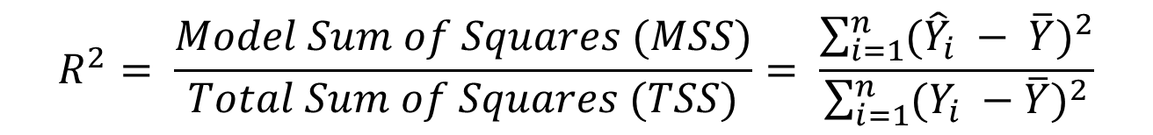
Partitioning (cont.)
Y | X1 | X2 | X3 | X4
1118 | 66 | 8 | 846.06 | 1
1107 | 49 | 1 | 87.44 | 0
1106 | 26 | 2 | 120 | 0
1148 | 145 | 1 | 782.08 | 1
. | . | . | . | .
. | . | . | . | .
. | . | . | . | .
2106 | 356 | 1 | 79 | 0
1104 | 264 | 1 | 318.5 | 0
. | . | . | . | .
. | . | . | . | .
. | . | . | . | .
Training Set:
build models
Validation Set:
select the “best” model
$$R^{2}= \frac{Model Sum of Squares (MSS)}{Total Sum of Squares (TSS)}= \frac{\sum_{i=1}^{n}{{({\hat{Y}}_{i} − \overline{Y})}^{2}}}{\sum_{i=1}^{n}{{(Y_{i} −\overline{Y})}^{2}}}$$

Slide 24
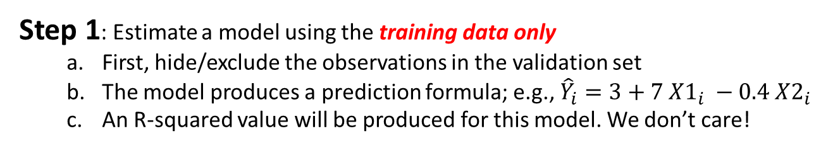
Partitioning (cont.)
Y | X1 | X2 | X3 | X4
1118 | 66 | 8 | 846.06 | 1
1107 | 49 | 1 | 87.44 | 0
1106 | 26 | 2 | 120 | 0
1148 | 145 | 1 | 782.08 | 1
. | . | . | . | .
. | . | . | . | .
. | . | . | . | .
2106 | 356 | 1 | 79 | 0
1104 | 264 | 1 | 318.5 | 0
. | . | . | . | .
. | . | . | . | .
. | . | . | . | .
Training Set:
build models
Validation Set:
select the “best” model
Step 1: Estimate a model using the training data only
First, hide/exclude the observations in the validation set
The model produces a prediction formula; e.g., ${\hat{Y}}_{i}=3+7 {X1}_{i} −0.4 {X2}_{i}$
An R-squared value will be produced for this model. We don’t care!

Slide 25
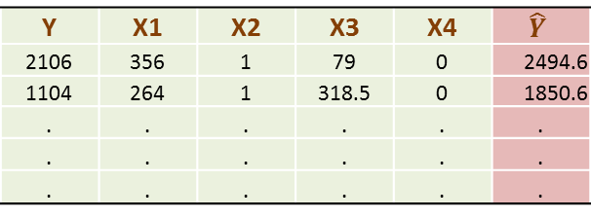
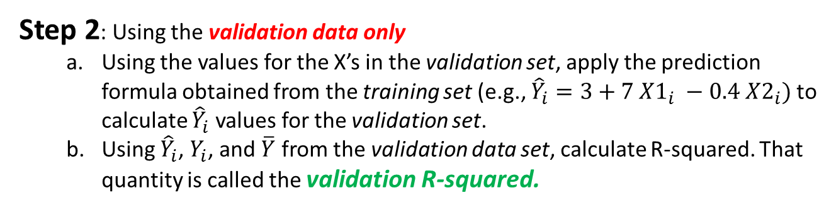
Partitioning (cont.)
Y | X1 | X2 | X3 | X4
1118 | 66 | 8 | 846.06 | 1
1107 | 49 | 1 | 87.44 | 0
1106 | 26 | 2 | 120 | 0
1148 | 145 | 1 | 782.08 | 1
. | . | . | . | .
. | . | . | . | .
. | . | . | . | .
Training Set:
build models
Y | X1 | X2 | X3 | X4 | $$\hat{Y}$$
2106 | 356 | 1 | 79 | 0 | 2494.6
1104 | 264 | 1 | 318.5 | 0 | 1850.6
. | . | . | . | . | .
. | . | . | . | . | .
. | . | . | . | . | .
Validation Set:
select the “best” model
Step 2: Using the validation data only
Using the values for the X’s in the validation set, apply the prediction formula obtained from the training set (e.g., ${\hat{Y}}_{i}=3+7 {X1}_{i} −0.4 {X2}_{i})$to calculate ${\hat{Y}}_{i}$ values for the validation set.
Using ${\hat{Y}}_{i}$, $Y_{i}$, and $\overline{Y}$ from the validation data set, calculate R-squared. That quantity is called the validation R-squared.

Slide 26
Partitioning (cont.)
Step 3
Repeat steps 1 and 2, estimating different models each time.
Choose as the best model the one with the highest validation R-squared.
Comprehension Check
True or false: The validation R-square is the same as the R-squared statistic produced from the validation data set.

Slide 27
The Importance Of Partitioning
Overfitting

